Slide 1
Capstone project – Car Accident Severity
Alejandro Graizer

Slide 2
CONTENTS OF THIS PRESENTATION
Here’s what you’ll find in this presentation:
Introductión.
Data.
Methodology & Analytics.
Results.
Decisions.
Conclusions.

Slide 3
TABLE OF CONTENTS
01
03
02
Methodology & Analytics - Results
Introductión and Data
Desicións and Conclusions

Slide 4
Introduction
Audience
Audience
Goverment
Road Authorities
Insurance companies
Vehicle manufacturers
Police Departments
Data labs
Roads Engineers

Slide 5
Problems
Trafic Jams
Lost of money in car accidents
People health
Life Quality of people in the cities

Slide 6
DATA
1ST Data set
2nd Data set
3rd Data Set
Selected Data Set
Not to updated
Wrong focus on the target variable
Only records when people got injured
Updated, with a lot of variables and a binary target variable
38 variables and 194,673 recorded accidents

Slide 7
Variables
ADDRTYPE
PERSONCOUNT
COLLISIONTYPE
SPEEDING
WEATHER
SEVERITYCODE

Slide 8
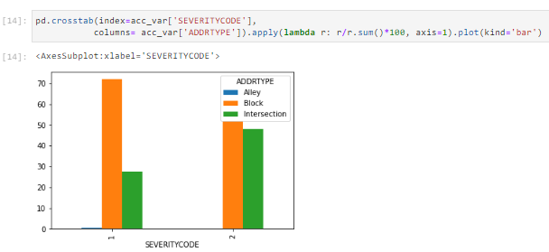
ADDRTYPE
AGE
80%

Slide 9
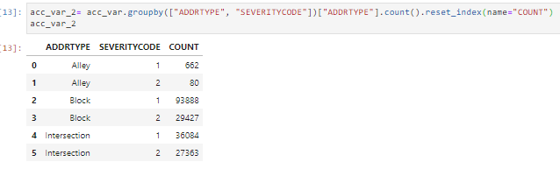
ADDRTYPE
AGE
80%

Slide 10
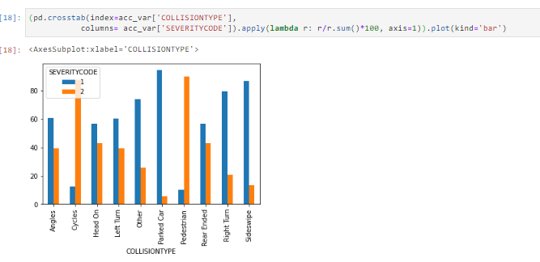
COLLISIONTYPE
AGE
80%

Slide 11
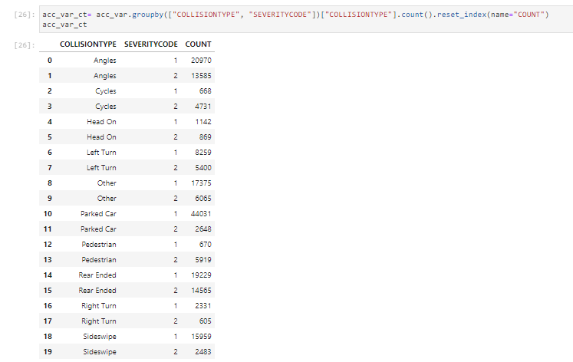
COLLISIONTYPE
AGE
80%

Slide 12
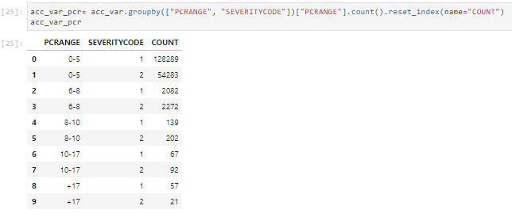
PC RANGE
AGE
80%

Slide 13
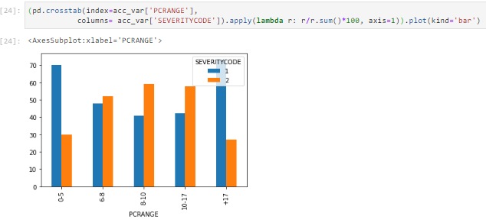
PC RANGE
AGE
80%

Slide 14
LOGISTIC REGRESSION
Logistic regression is a statistical model that in its basic form uses a logistic function to model a binary dependent variable. In regression analysis, logistic regression is estimating the parameters of a logistic model (a form of binary regression). Mathematically, a binary logistic model has a dependent variable with two possible values, such as pass/fail which is represented by an indicator variable, where the two values are labeled "0" and "1".
I decided to perform a logistic regression because my case is very similar to the typical characteristics of these. In my case, the target variable is also a binary variable. It only takes as results "1" or "2" and this is an identification of the associated accident. "1" if there was only material damage and "2" if there were injured people.

Slide 15
LOGISTIC REGRESSION
To do the logistic regression, I had to treat all the categorical variables to transform them into numerical variables. This process consisted in turning each categorical variable into a dummy variable.
I decided to make my model by separating all my dataset in one part to make the train of the model and another part to make the test of the model. I preferred to take this measure because to make the test with a part of the dataset that was taken to make the train of the model can lead to compete in overfitting errors.
I took 80% of the data to develop the model (train set) and the remaining 20% of the data I used to test the model and compare the value predicted by the model against the actual value in the database.

Slide 16

RESULTS
JACCARD SIMILARITY SCORE
The size of the intersection divided by the size of the union of two label sets, is used to compare set of predicted labels for a sample to the corresponding set of labels in y_true

Slide 17
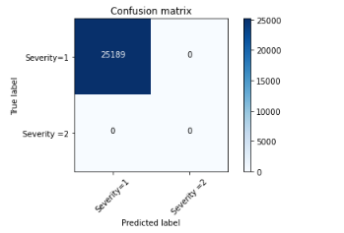
RESULTS
CONFUSSION MATRIX
. Each column of the matrix represents the number of predictions for each class, while each row represents the instances in the actual class. One of the benefits of confounding matrices is that they make it easier to see if the system is confusing two classes

Slide 18
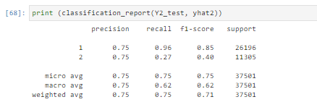
RESULTS
CLASSIFICATION REPORT
The recall means "how many of this class you find over the whole number of element of this class"
The precision will be "how many are correctly classified among that class"
The f1-score is the harmonic mean between precision & recall
The support is the number of occurence of the given class in your dataset

Slide 19

RESULTS
LogLoss
This metric quantifies the accuracy of a classifier by penalising false classifications. The closer this value is to 0, the better the predictive value of the model. Otherwise, the LogLoss is close to 1.

Slide 20
DECISIONS
The government, the Police, the road authorities have to start taking resignations from when these accidents occur and under what circumstances these accidents are most likely to be serious or not. Clearly, after this report the authorities have to take into account that, for example, it is in the road intersections that a serious accident is most likely to occur. It is there, then, that they should take extreme precautionary measures and ensure that everything follows the rules so that the number of events is reduced.
It is also very likely that there will be serious accidents, when there are many people involved (more than 6). It is in this way that those companies that are dedicated to the manufacture of large vehicles, in which more people enter, should review their processes, improve their products to reduce the number of accidents or at least ensure that when they happen, there are no injuries between people (not accidents of severity 2).

Slide 21
CONCLUSIONS
In this study I have analyzed the relationship between the number of people in an accident, the type of road and the type of accident with the severity of such event. This report can serve as a basis for taking action on a city's road system. It can be seen how the number of accidents that occur in a city greatly affects the lives of its inhabitants. It is a high priority to make all possible changes so that they do not occur or are at least not as severe.
In the same vein, I think it is important that governments begin to realize how useful these analyses can be and to encourage them. The best way to do this could be to commission a data collection team or department within each city. I have done this report in general for all cities but it can be very valuable to have more data, with more characteristics about accidents. For example, to know the location, if there was a responsible, age of the people involved, time of the accident and other specific characteristics of each City so that when making the studies more precise measures can be taken of each situation.

Slide 22
THANKS

